Slide 1

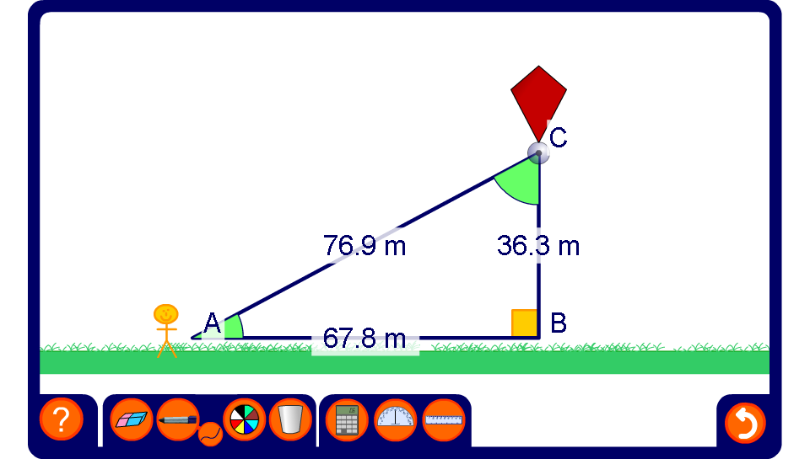


Finding angles
Notes:
Use this activity to practice finding the size of angles given two sides in a right-angled triangle.

